Slide 1
EMERGENCE OF BANGLADESH
CAPITALIST DEVELOPMENT
AND REGIONAL DISPARITY IN PAKISTAN
1947-1970

Slide 2


Slide 3
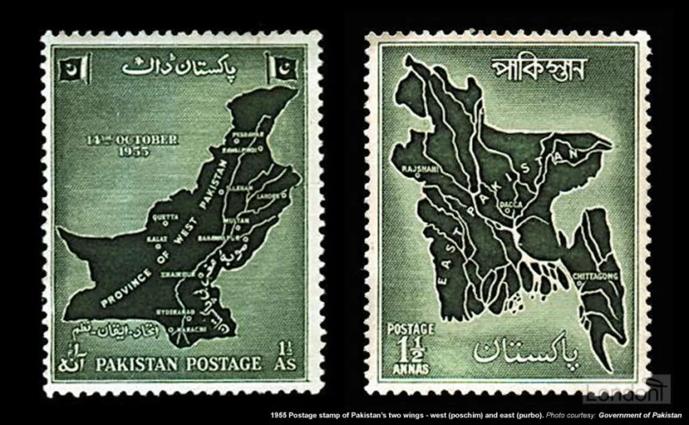
OUTLINE:
Learning Objectives:
Identify the causes of economic disparity between East and West Pakistan
Recognize how the capitalist development strategy in Pakistan led to regional and income inequality
Understand the 6 points as a program for the economic independence of East Pakistan

Slide 4
Capitalist Development
Capitalism: an economic system based on the private ownership of the means of production and their operation for profit
Socialism: a socio-economic system in which property and the distribution of wealth are subject to control by the workers (directly through popular collectives such as workers’ council or indirectly exercised on behalf of the people by the state
Capitalist Development: Industrialization, Rise of Employment, Trickle-down Theory, short-term Losses will result into long-term gains

Slide 5
Cold War
After WWII
USA and USSR
Capitalism vs Socialism
Political, Economic, Proxy Wars
Vietnam war
Influence of USSR and China particularly in South-East Asia

Slide 6
Dependency Theory and World System Theory
Dependency Theory: Core and Periphery
World System Theory: Core, Periphery and Semi-periphery
India and Pakistan which one is which? Influence of British rule?
India with most of the industries
Pakistan had some

Slide 7
After 1947
People in EP voted for ML having big ambitions about the new Pakistan
Within the first few months their dreams and ambitions were shattered- due to the attack on language and cultural frontiers
Internal Colonialism- economic imbalances within a state where one or more regions of the state taking advantage of other regions
Increasing exploitation of EP by WP

Slide 8
After 1947
From USA Harvard Advisory Group
Pakistan was picked up as a model of capitalist development by USA
Pakistan also accepted it but why?
Industries in India and Pakistan
Political, administrative and military structure
Political ambition of Pakistan to catch up to India
In beginning, Pakistan did not have any industrialist class.

Slide 9
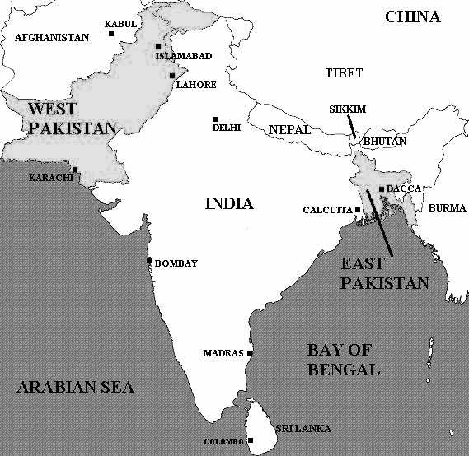
INITIAL CONDITIONS: EAST & WEST PAKISTAN
West: slightly better roads, railways irrigation & power
East: fertile land, high rainfall, well developed system of waterways
Both wings had very low industrial capacity though EP had a strong rural handloom industry
Low educational attainment in both wings
But WP had strong army; and Muslim civil bureaucrats and Muslim traders from India emigrating to WP

Slide 10
ECONOMIC CONDITIONS OF EAST PAKISTAN IN 1947
Metropolitan Kolkata and East Bengal hinterland
Hindu zamindars and Muslim tenant and small holder farmers
Trade, commerce, financial intermediation and
rural industries dominated by Hindus
Tea industry and mechanized river transport owned by British
Bureaucracy, teaching and legal professions in EB dominated by Hindus
Bengali Muslim expectation of advancement through Pakistan

Slide 11
Capitalist Development in Pakistan
Created industrialist class-22 families (only 1 from EP- AK Khan family)
Economic growth
Inequalities increased-rich get richer and poor get poorer
Exploitation of EP

Slide 12
CAPITALIST ECONOMIC PLANNING IN PAKISTAN
Overvaluation of currency:
Jute growers in EP received 50% less for their export
Foreign exchange control and import licensing system: Industry owners in WP paid less for machine imports
State promotion of WP industry:
Low interest loans, over invoicing for initial capital
Monopoly protection of domestic products at high prices
State established enterprises transferred to private hands
(sugar, fertilizer, cement, machine tools, electrical, petro-chemicals)
Massive US foreign aid to Pakistan

Slide 13
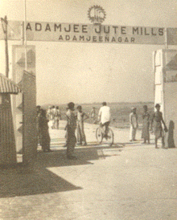
DOMINANCE OF NON-BENGALIS IN EP PRIVATE SECTOR
Non-Bengalis:
received 62% of all state industrial lending in EP
received PIDC set up factories (jute mills and Karnaphuli paper mill)
controlled 47% of industrial assets compared to 23% by Bengalis (the rest by EPIDC)
controlled 93% of all large imports, most wholesale trade, exports
70% of all deposits in Non-Bengali banks
owned 2 of the largest 3 shipping companies
owned 28 tea gardens with 19% of tea output

Slide 14
GROWTH OF DISPARITY: PER CAPITA INCOMES
Year | East Pakistan Rupees | West Pakistan Rupees | Disparity (2-1) | Disparity ratio 2-1x100
1949/50 | 288 | 351 | 63 | 21.9
1954/55 | 294 | 365 | 71 | 24.1
1959/60 | 277 | 367 | 90 | 32.5
1964/65 | 303 | 440 | 137 | 45.2
1969/70 | 331 | 533 | 202 | 61.0

Slide 15
GROWTH OF DISPARITY: PER CAPITA INCOMES
West Pakistanis earned about 22% more than East Pakistanis
Instead of going down, this inequality increased
In 1969/70- West Pakistanis earned about 61% more than East Pakistanis

Slide 16
DISPARITY: BASIC CONSUMPTION EXPENDITURES
Commodity | Unit of Measurement per capita | 1951-52 |  | 1963-64
 |  | EP | WP | EP | WP
Cereals | Per oz. p.d. | 14.9 | 15.7 | 16.8 | 17.4
Sugar | Per oz. p.m. | 24.5 | 43.5 | 10.2 | 38.4
Tea | Per oz. p.m. | 0.13 | 0.6 | 0.16 | 1.12
Cloth | Yds. p.a. | 1.7 | 1.4
Kerosene | Gallon p.a. | 0.5 | 0.5
Paper | Lbs. p.a. | 0.2 | 0.5
Milk and Butter | Lbs. p.m. |  |  | 2.1 | 8.6
Mutton, beef and fish | Lbs. p.m. |  |  | 0.4 | 1.7
 |  | 1960 |  | 1966-67
Household in Rs. monthly consumption expenditure |  | 121.9 | 143.8 | 151.5 | 211.4
Rice price Wheat price | Rs per ton Rs per ton |  |  | 518 517 | 334 267

Slide 17
DISPARITY: BASIC CONSUMPTION EXPENDITURES
In terms of Consumption
For Milk and Butter (lbs per month)- EP 2.1 and WP 8.6
For Mutton, Fish and Beef (lbs per month)- EP 0.4 and WP 1.7
In terms of Price
For Rice - EP 518/ton and WP 334/ton
For Wheat- EP 517/ton and WP 267/ton

Slide 18
DISPARITY: SOCIAL AND PHYSICAL INFRASTRUCTURE
Item | Unit of Measurement per capita | 1951-52 |  | 1959-60 |  | 1967-68
 |  | EP | WP | EP | WP | EP | WP
Electricity | Kwh. p.a | 0.5 | 8.6 | 1.6 | 28.8 | (Total generating capacity on Dec. 1969)
 |  |  |  |  |  | 378 MW | 1559 MW
Route mileage of railways | Miles | 1682 | 5316 | 1714 | 5327 | 1712 | 5334
Road mileage | Miles | 405 | 17152 | 1040 | 19684 | 2588 | 22508
Motor Vehicles | Number | - | - | 14410 | 109228 | 56285 | 259395
No. of radio licenses issued |  | 8848 | 70513 | 37713 | 293607 | 358241 | 738215
Hospital beds |  | - | - | 4973 | 22100 | 6984 (1966) | 26200 (1966)
Doctors |  | - | - | 5492 | 6132 | 88100 (1969) | 131000 (1969)

Slide 19
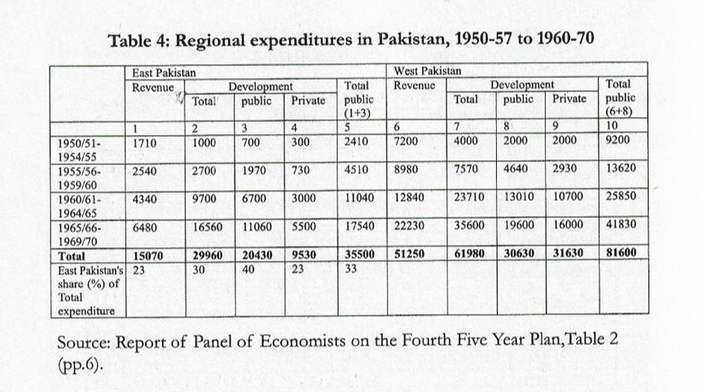
DISPARITY: REGIONAL EXPENDITURES, 1950-57 TO 1960-70

Slide 20
DISPARITY: REGIONAL EXPENDITURES, 1950-57 TO 1960-70
Govt expenditure on development in EP was 35 billion
EP-33%
WP-66%

Slide 21
DISPARITY: DISTRIBUTION OF AID FLOWS, 1948/49 - 1968/69
AID DISTRIBUTION CONVERTED TO RS. AT $ SCARCITY VALUE (IN RS. BILLION)
 |  | East Pakistan | West Pakistan | Total
1 | 1948/49 – 1960/61 | 4.84 | 10.77 | 15.61
 | per cent | 31.0 | 69.0 | 100.0
2 | 1961/62 – 1968/69 | 14.49 | 31.48 | 45.97
 | per cent | 31.5 | 68.5 | 100.0
3 | Total | 19.33 | 42.25 | 61.58
 | per cent | 31.4 | 68.6 | 100.0

Slide 22
DISPARITY: DISTRIBUTION OF AID FLOWS, 1948/49 - 1968/69
EP got only 31% of foreign aid
WP got 69%
Consider the population

Slide 23
Balance of Payment
Import-Export
Import>Export= (-)
Export>Import= (+)

Slide 24
DISPARITY: BALANCE OF PAYMENTS (1948/49-1968/69) (RS. MILLION)
 |  | East Pakistan | West Pakistan
1948-49 to 1960-61 | Nominal price | +592 | -8116
 | Scarcity price | +5368 | -20989
1961-62 to 1968-69 | Nominal price | -6526 | -18180
 | Scarcity price | -9386 | -34075
Total |  | -5934 | -26296
1948-49 to 1968-69 | Nominal price
 | Scarcity price | -4018 | -55064

Slide 25
DISPARITY: TRANSFER OF RESOURCES 1948/49 TO 1968/69 (RS. MILLION)
 |  | 1948/49- 1960/61 | 1961/62-1968/69 | 1948/49-1968/69
1 | Aid actually utilized in East Pakistan | 4840 | 14490 | 19330
2 | East Pakistan’s due share of aid in proportion to population | 8430 | 26710 | 35140
3 | Transfer from East to West on Aid account (2-1) | +3590 | +12220 | +15810
4 | East Pakistan’s balance of payments | +5370 | -9390 | -4020
5 | Transfer of resources from East to West (3+4) | +8960 | +2830 | +11790

Slide 26
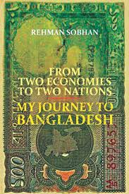
BENGALI ECONOMISTS FIGHT BACK
From 1960 onwards, Bengali economists proactively and persistently pointed out the structural basis of regional discrimination inherent in Pakistan’s economic policies
Those who led this critique and active debate that anchored the demand for regional autonomy, include:
Professor Akhlaqur Rahman
Professor Nurul Islam
Professor Rehman Sobhan
Professor Mosharraf Hossain
Professor Anisur Rahman

Slide 27
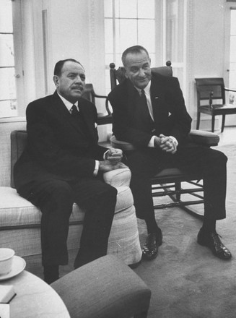
CAPITALIST ECONOMIC PLANNING IN PAKISTAN
Harvard Advisory Group celebrated capitalist development in Pakistan as model against socialism (1968)
The Decade of Development (1958-68): Impacts
regional inequality
income inequality and impoverishment of peasantry & workers
rise of 22 families (only 1 from EP)
powerful bureaucracy and army
affluent urban upper class

Slide 28
SIX POINTS: ECONOMIC INDEPENDENCE OF EP
Federation of Pakistan based on the Lahore Resolution; and a parliamentary form of government directly elected on the basis of universal adult franchise.
Federal government controls only two subjects - defense and foreign affairs. All other subjects vested in the federating states.
Two separate, but freely convertible currencies for two wings. If this is not feasible, then one currency for the whole country, but effective constitutional provisions to stop the flight of capital from EP to WP.
Power of taxation and revenue collection vested only in the federating units, not the federal center.
Two separate accounts for foreign exchange earnings of two wings; each empowered to establish trade links separately with foreign countries.
East Pakistan to have a separate military or paramilitary force, and navy headquarters should be in East Pakistan.

Slide 29
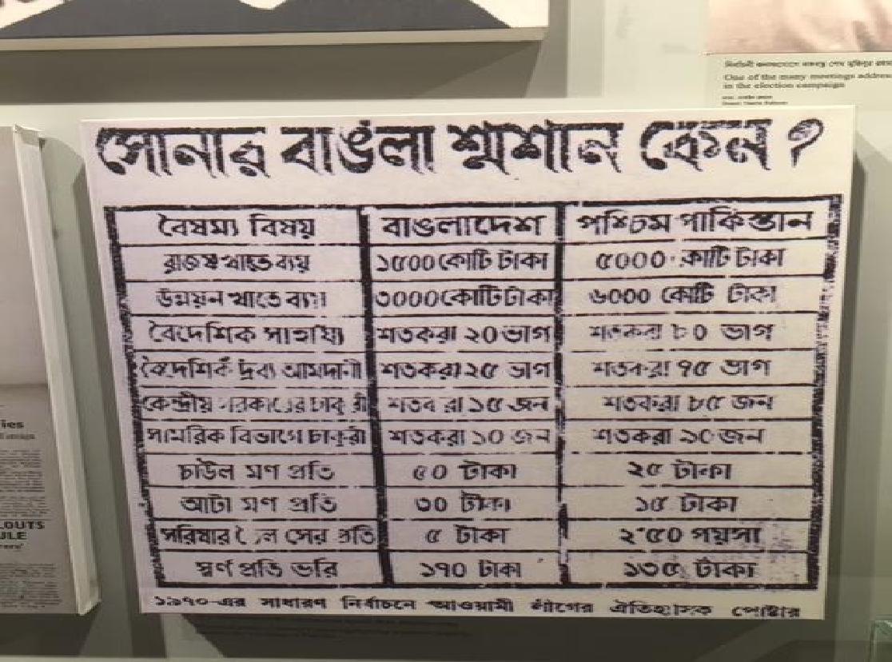
GOLDEN BENGAL NOW A GRAVEYARD!

